Slide 1
Navigating the Future of Online Shopping
A Python & SQL Analytics Project Questions
Presented by Vishal Maurya

Slide 2
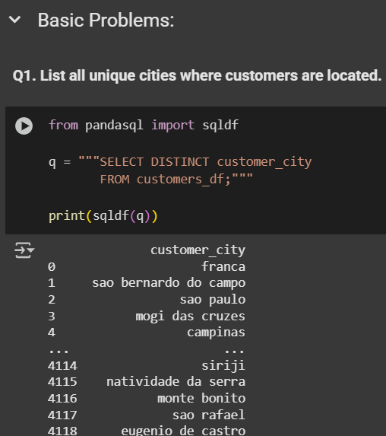
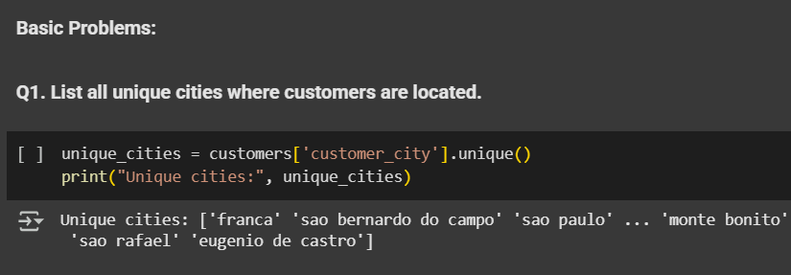
BASIC PROBLEMS: Objective: Extract fundamental insights from the dataset. Q1. List all unique cities where customers are located.

Slide 3
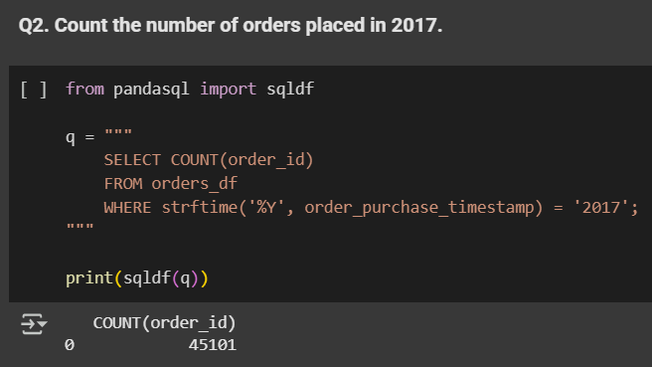
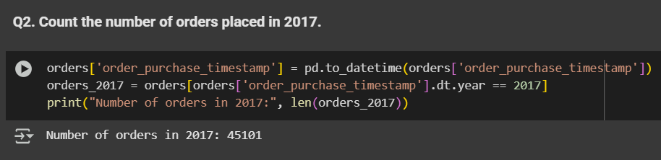
Q2. Count the number of orders placed in 2017.

Slide 4
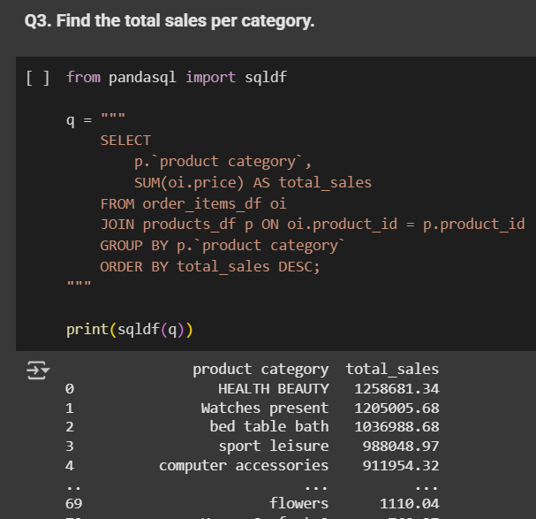
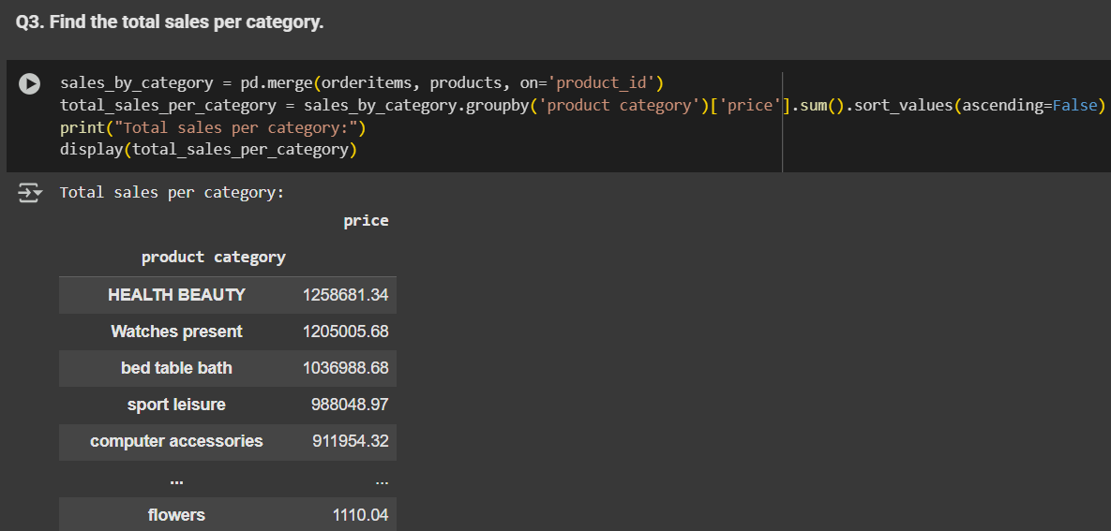
Q3. Find the total sales per category.

Slide 5
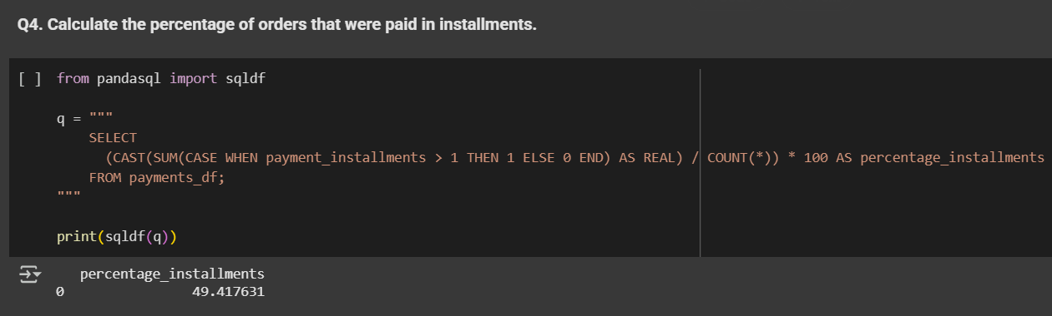
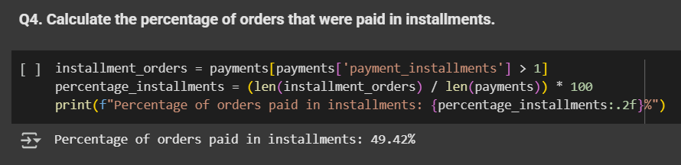
Q4. Calculate the percentage of orders that were paid in installments.

Slide 6
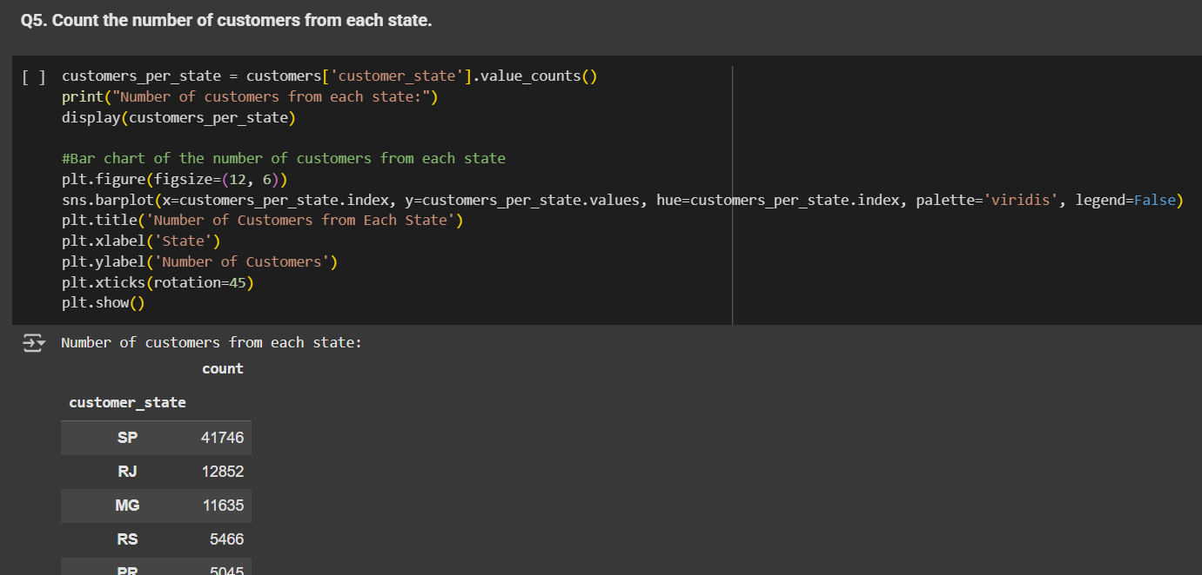
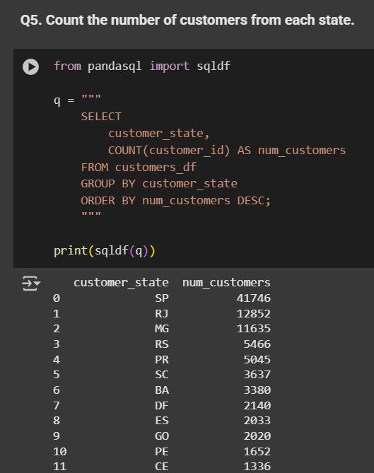
Q5. Count the number of customers from each state.

Slide 7
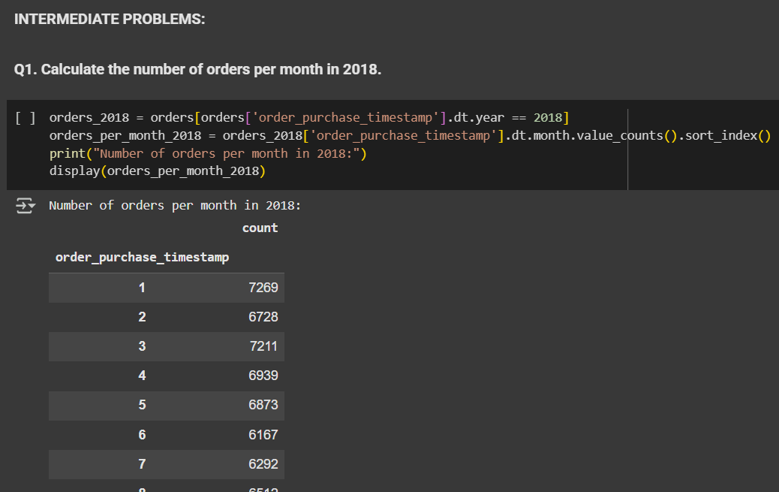
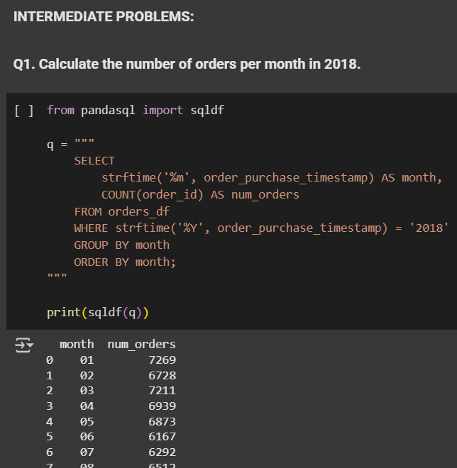
INTERMEDIATE PROBLEMS: Objective: Dive deeper into sales and order trends. Q1. Calculate the number of orders per month in 2018.

Slide 8
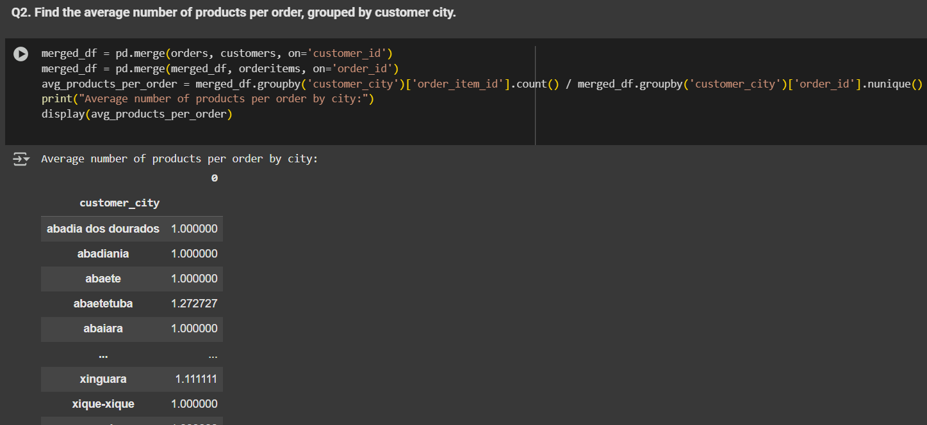
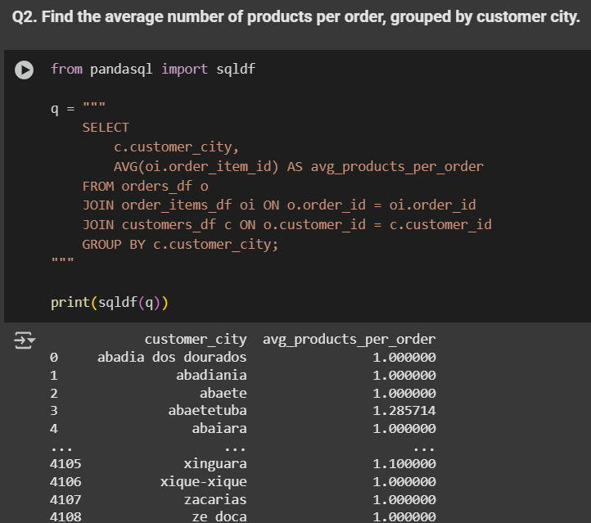
Q2. Find the average number of products per order, grouped by customer city.

Slide 9
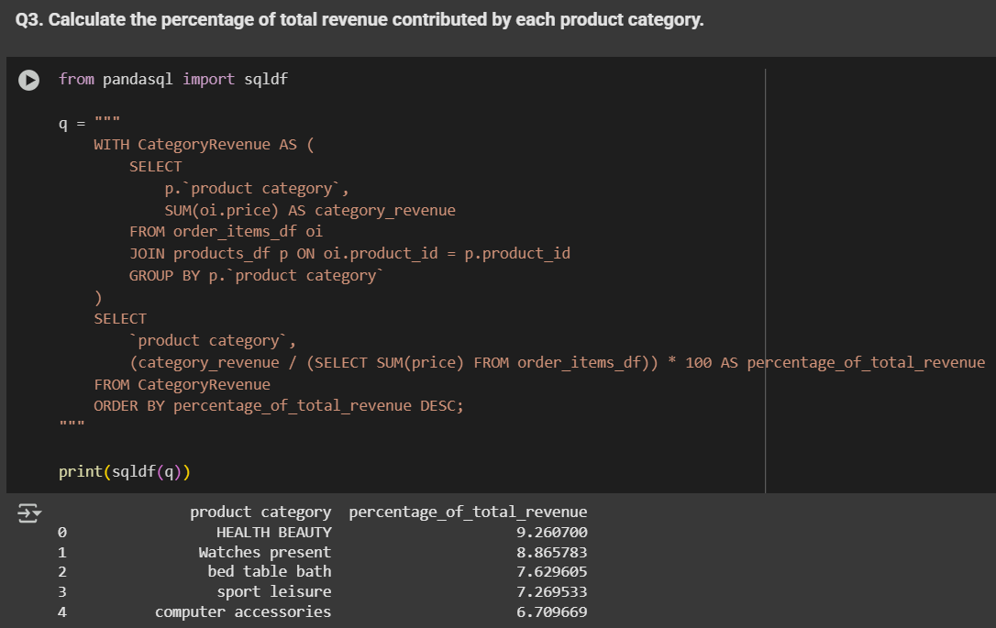
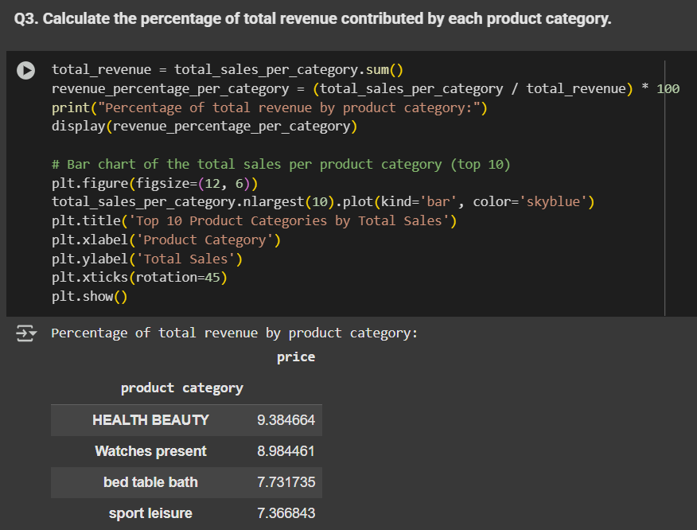
Q3. Calculate the percentage of total revenue contributed by each product category

Slide 10
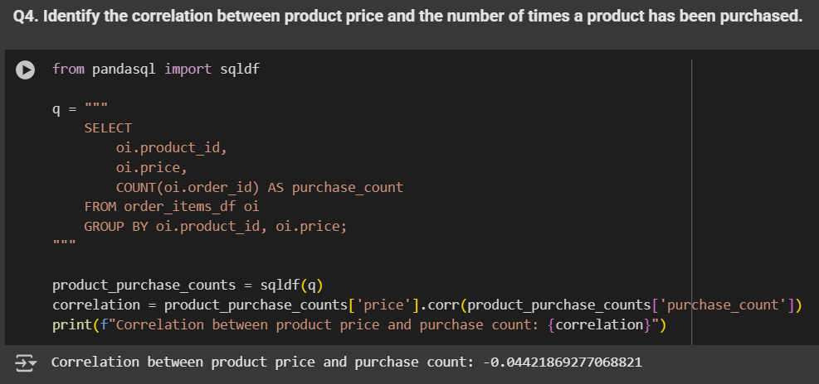
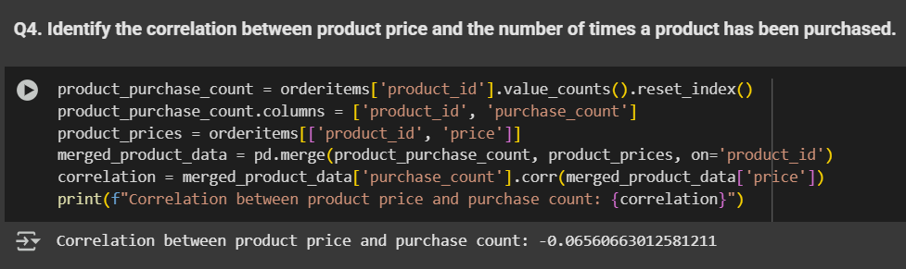
Q4. Identify the correlation between product price and the number of times a product has been purchased.

Slide 11
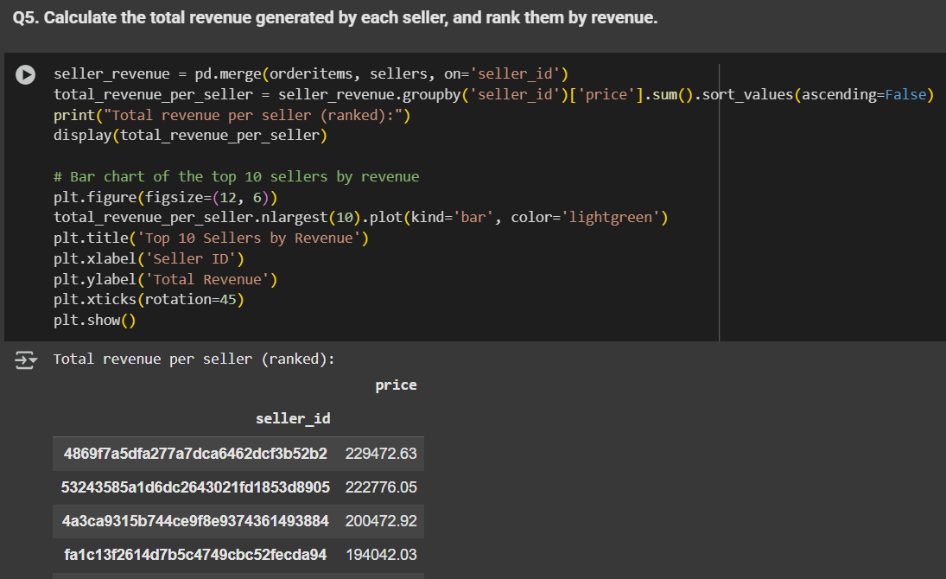
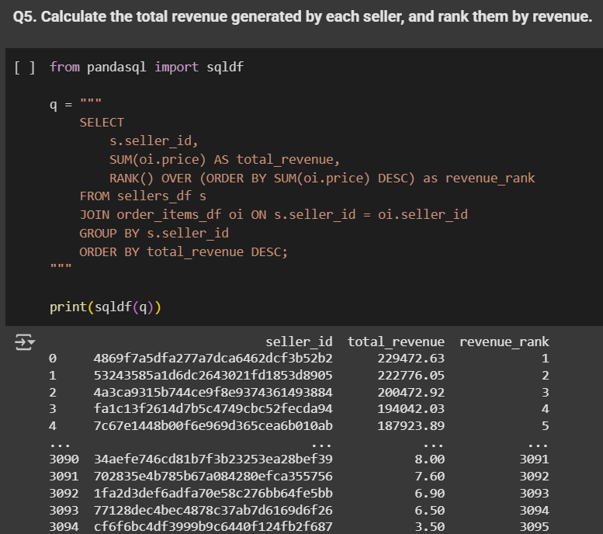
Q5. Calculate the total revenue generated by each seller, and rank them by revenue.

Slide 12
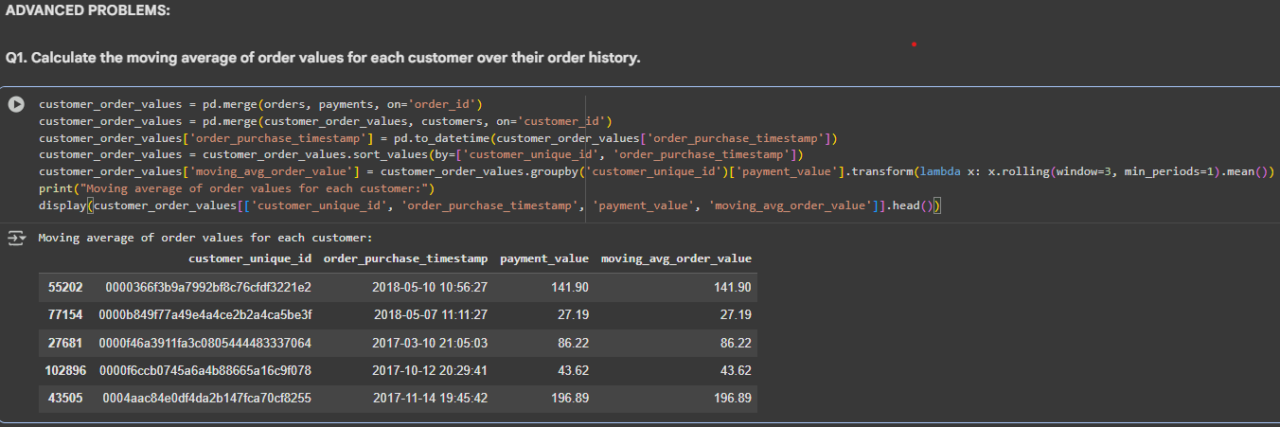
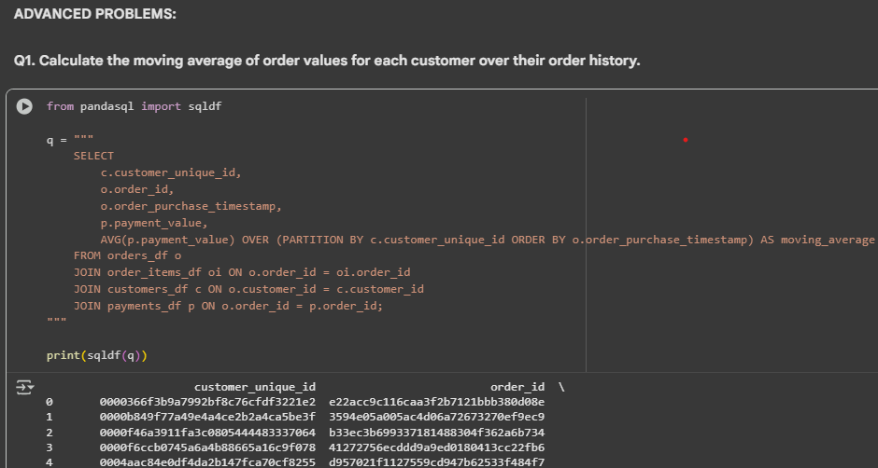
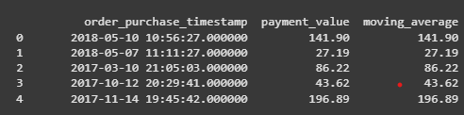
ADVANCED PROBLEMS: Objective: Generate strategic and customer-centric insights. Q1. Calculate the moving average of order values for each customer over their order history.

Slide 13
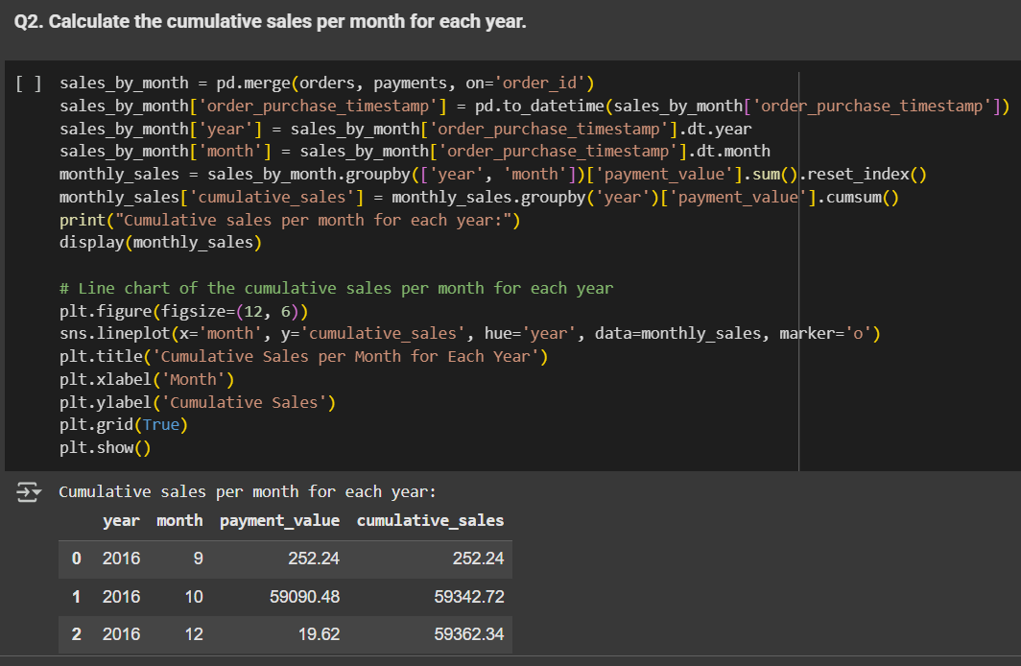
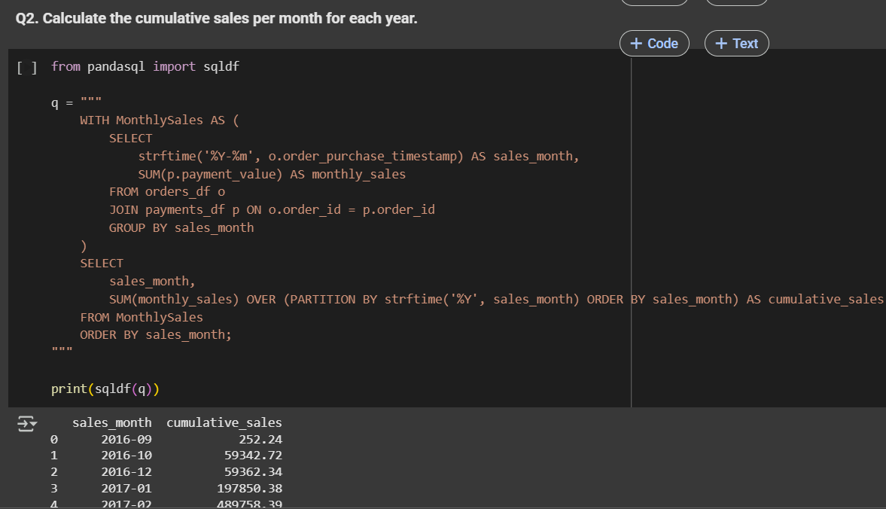
Q2. Calculate the cumulative sales per month for each year.

Slide 14
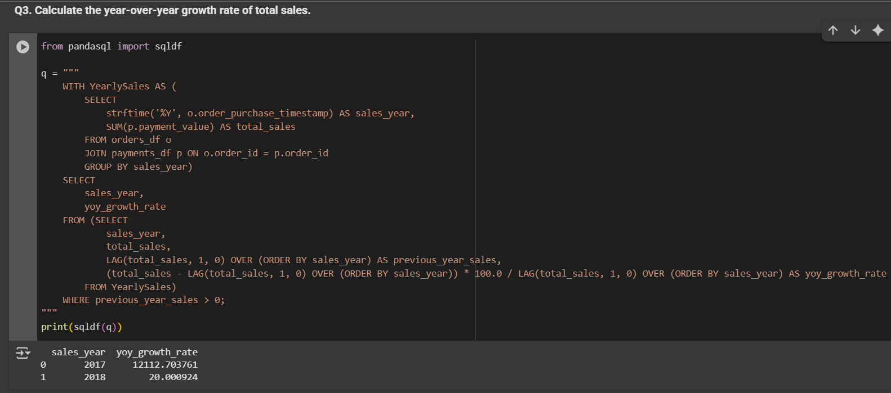
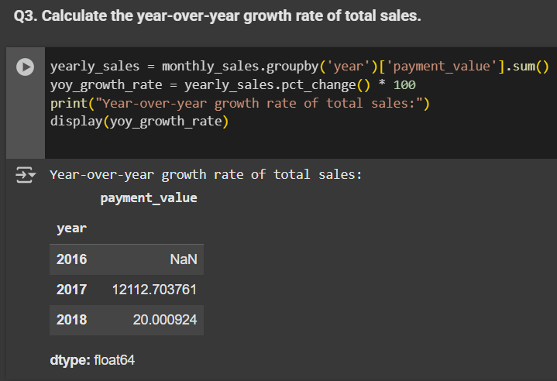
Q3. Calculate the year-over-year growth rate of total sales.

Slide 15
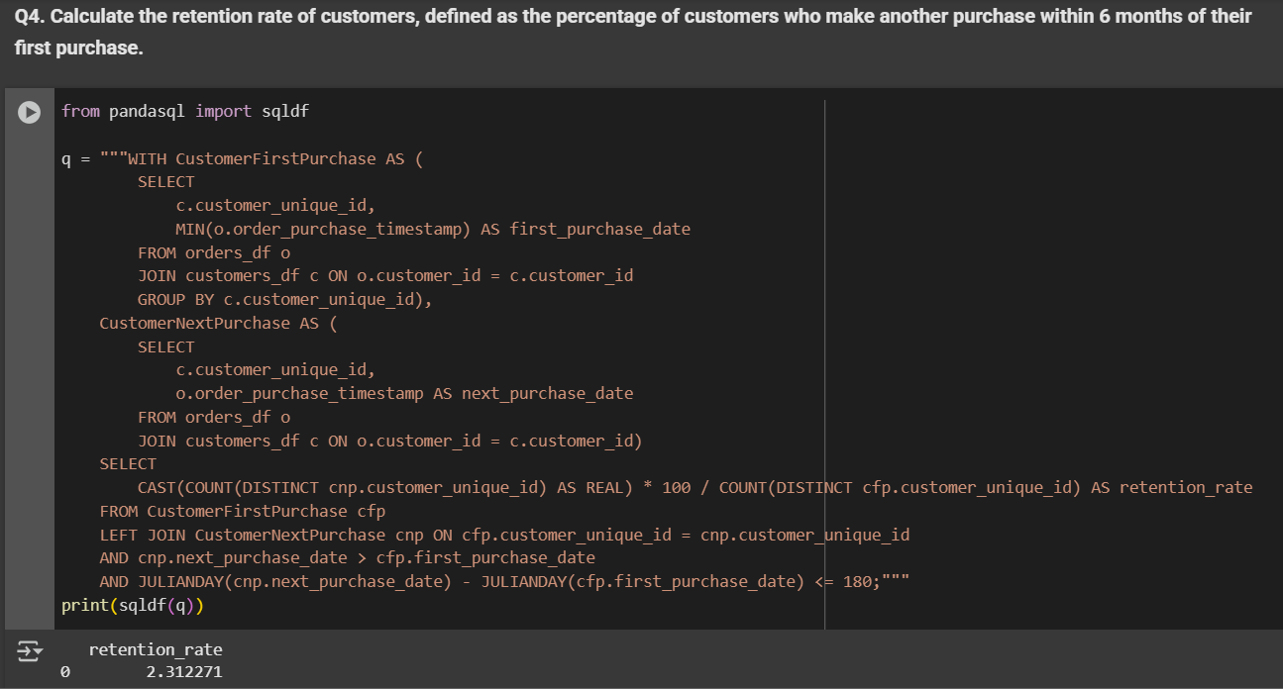
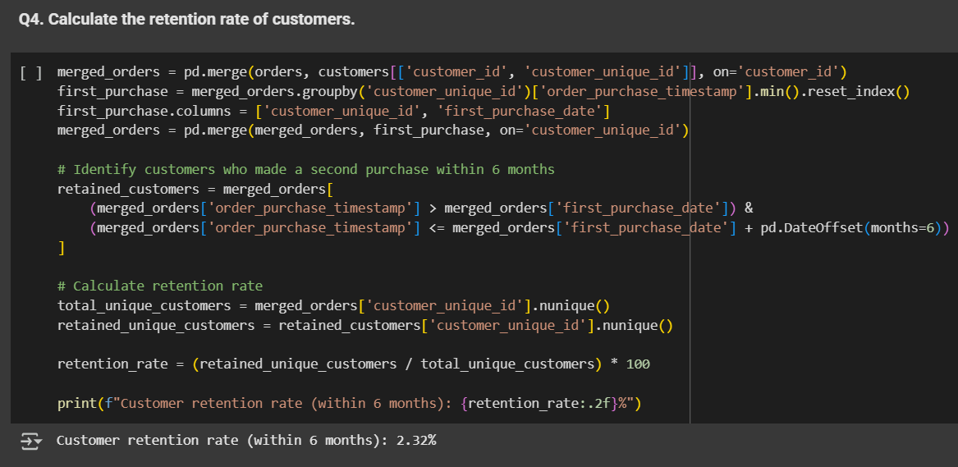
Q4. Calculate the retention rate of customers, defined as the percentage of customers who make another purchase within 6 months of their first purchase.

Slide 16
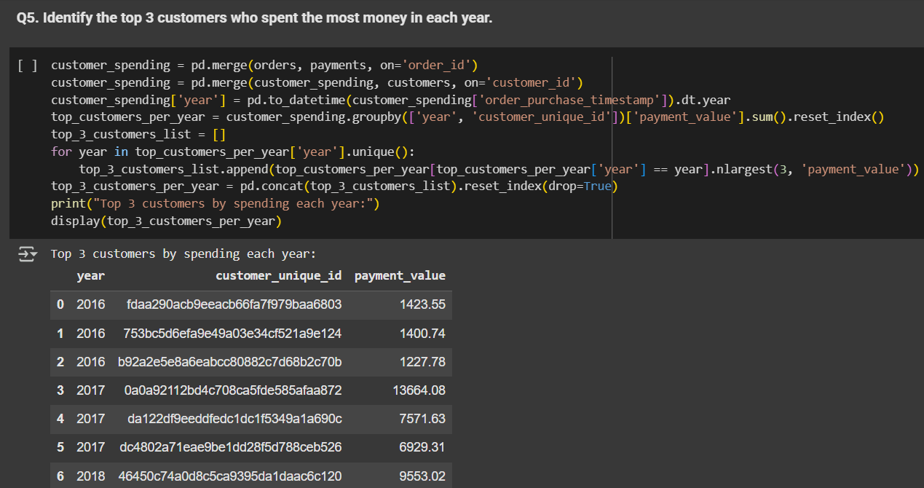
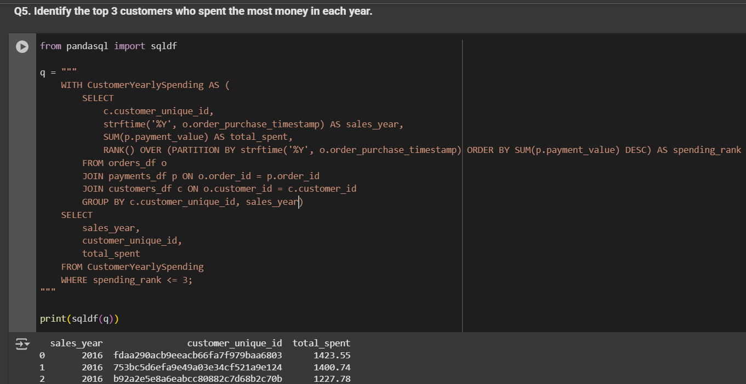
Q5. Identify the top 3 customers who spent the most money in each year.

Slide 17
Insights & Recommendations
Focus marketing on SP, RJ, MG to deepen presence
Expand popular product categories
Invest in customer retention (loyalty, targeted offers)
Continue flexible payment options (installments)
Train/support underperforming sellers
Premium engagement for top customers

Slide 18
Conclusion
The platform has built a strong presence in Brazil’s largest markets, with São Paulo, Rio de Janeiro, and Minas Gerais driving the bulk of transactions and revenue.
Early-stage explosive growth has stabilized, indicating the business is now entering a phase of market maturity. To maintain momentum, a shift in focus from rapid expansion to customer retention and long-term value is essential.
Despite a broad geographic reach, customer acquisition is highly concentrated—many states remain underpenetrated. This presents an opportunity to diversify growth by tailoring strategies for low-activity regions.
Retention rates are currently low, but this gives significant upside should effective loyalty strategies, personalized outreach, and re-engagement campaigns be deployed.
Flexible payments and a diverse product catalog are strong competitive advantages, matching customer preferences and allowing wider market appeal.

Slide 19
THANK YOU
Thank you for watching!
Contact :- vishalmaurya491@gmail.com
LinkedIn :- www.linkedin.com/in/vishalmaurya29
GitHub :- https://github.com/vishal29102002

